Slide 1

GF application grammars in a resource scarce environment
Laurette Marais
Notes:
Hello, my name is Laurette Marais and today I will be talking about how GF has been used in a resource scarce environment to enable language and specifically speech applications. I am

Slide 2
Outline
What is resource scarce?
Why use GF application grammars?
AwezaMed S2S translation app
Which corners to cut?
NN instead of concrete syntax
Question-understanding
Conclusion
Notes:
My talk will have the following outline
First I will attempt to give an idea of what I mean when I talk about resource scarcity, specifically in the South African context ...
… before touching on why we use GF
Then I will talk a bit about a multilingual speech to speech translation application we built using GF
Next, I will explain the workflow we have followed so far for developing GF application grammars, and where the resource scarcity is most felt
The next part will describe how we’ve tried to use a resource grammar to adapt the workflow using machine learning, specifically neural networks
I will conclude with some remarks about what we have learnt

Slide 3
What is resource scarce?
Computational and linguistic skills
Education in South Africa
~ 1.1M Grade 1’s in 2008, ~ 441K passed senior certificate in 2020 (with 40+%)
Senior certificate is written in Afrikaans or English
All languages can be written as home language and first or second additional language
Zulu HL: 143 364, Ndebele HL: 4 621
By Grade 5, 63% of learners have not acquired basic mathematical knowledge¹
Mathematics 60+%: 30 882
1. Trends in International Mathematics and Science Study 2019, https://timssandpirls.bc.edu/timss2019
Notes:
In the NLP world, the term “resource scarce” is often discussed in terms of digital resources, but today I want to start a bit earlier in the process, with human resources. My opinion, and I know that it is shared by many NLP colleagues in South Africa, is that our greatest scarcity is in skills. Of course, it starts with education.
Unfortunately, South Africa’s education is not in a good state. For example, in 2008, more than 1 million 6 or 7 year olds started primary school, and 12 years later, only about 40% of them passed their senior certificate, or matric, where passing requires achieving 40% in a home language subject and two others, and 30% in three other subjects.
Since we are concerned with language and computation skills, it is worth looking specifically at the school results for language and mathematics. Although South Africa has 11 official languages, the senior certificate exam can only be written in English and Afrikaans. In principle, the first three years of school are taught in all languages, but not in all schools - the language of tuition usually depends on the majority of speakers in the area around the school. From Grade 4, however, the official language of tuition is either English or Afrikaans, although by far the majority are taught in English.
However, all official languages can be taken as home language subject (which is then taught and written in the relevant language), or they can be taken as first or second additional language. Again, however, the specific subjects taught in any particular school depend on a number of factors, most typically the availability of teachers. About 33% of matriculants wrote (and almost all of them passed) the Zulu home language paper in 2020, which is about 10% more than the expected number of matriculants who speak Zulu as a home language. On the other hand, only about half the number of Ndebele matriculants wrote and passed the Ndebele home language paper.
Still, if you consider how many kids started school 12 years before, only about 13% of learners achieved 40% or more in Zulu home language 12 years later, and none of them were taught in Zulu beyond 3rd grade. Suffice to say, this is not a large pool from which to extract budding Zulu linguists.
Mathematics education is particularly problematic in South Africa. A recent international study found that by grade 5, almost two third of learners cannot do basic mathematics. This is born out in the senior certificate numbers, which show that out of 1.1M learners who started school in 2008, less than 31 000 passed mathematics with a mark high enough to be admitted to a STEM degree at university.
All this to say that finding students, engineers and researchers to work on things like grammar engineering is quite difficult.

Slide 4
What is resource scarce?
Zulu
11.5M HL speakers (2011)
Official language of South Africa (one of 11)
9 174 Wikipedia articles (seems to be mostly stubs), 28 active registered users
Largest parallel English-Zulu corpora:
JW300 ~1.1M sentences
Autshumato ~35k sentences
Morphological analyser, RG in progress²
2. https://github.com/LauretteM/gf-rgl-zul
Notes:
Let us focus on Zulu as a language. It is the largest home language in South Africa, with about 11.5M speakers, and it is understood by about half of South Africans. (Of which, sadly, I am not yet one.)
It is one of 11 official languages in South africa.
Since Wikipedia is often a useful indication of a language’s digital presence, we can note that it has less than 10 000 Wikipedia articles, and most of them are no longer than one sentence.
I managed to click on the random article button long enough - about 50 times - to find an article containing four sentences. It has 28 active registered users.
There are two English-Zulu parallel corpora that are used to perform machine learning on.
People usually train their systems in the Jehovah’s Witness corpus, before finding out that their model performs terribly when they test against the Autshumato corpus.
That’s because the former contains mostly religious material, while the latter is composed mostly of text scraped from government websites.
With regards to other kinds of resources, the most relevant one is the XFST ZulMorph analyser, which remains the state of the art for Zulu. This was developed by my mother and colleague, the other Laurette, and Zulu linguist Sonja Bosch.
And then the other Laurette and I are working on a resource grammar, on which I will say more tomorrow.

Slide 5
Why use GF application grammars?
The voice applications we target tend to
Be high risk (why?)
Involve “producer tasks”
Concern a limited domain
Be required in multiple (resource scarce) languages
Notes:
I work for the CSIR, which is South Africa’s Council for Scientific and Industrial research.
I am in the Voice Computing research group and our focus is on speech technology for the South African languages.
So why would we use GF application grammars in our work? I think those who know and love GF can probably guess.
In a multilingual country, it seems useful to target areas of miscommunication where it presents a real problem. Very often, this has to do with literacy, because South Africans’ proficiency in English tends to correlate with their socio-economic status. Miscommunication therefore tends to happen where people have lower socio-economic status, and so you are essentially targeting a relatively vulnerable population with little technical proficiency. In such a context, accuracy and particularly context appropriate translation is crucial. GF is ideal for this. Black box machine learning systems trained on Hebrew poetry or government press releases are not.
In such a setting, you are also often dealing with a producer task. For example, a doctor trying to communicate with a patient is more like a producer, in terms of his or her responsibilities, than a consumer.
Also, miscommunication issues often present themselves in specific, and even limited, domains, such as health care. And often, the need is for translation between many languages, and not a single language pair.

Slide 6
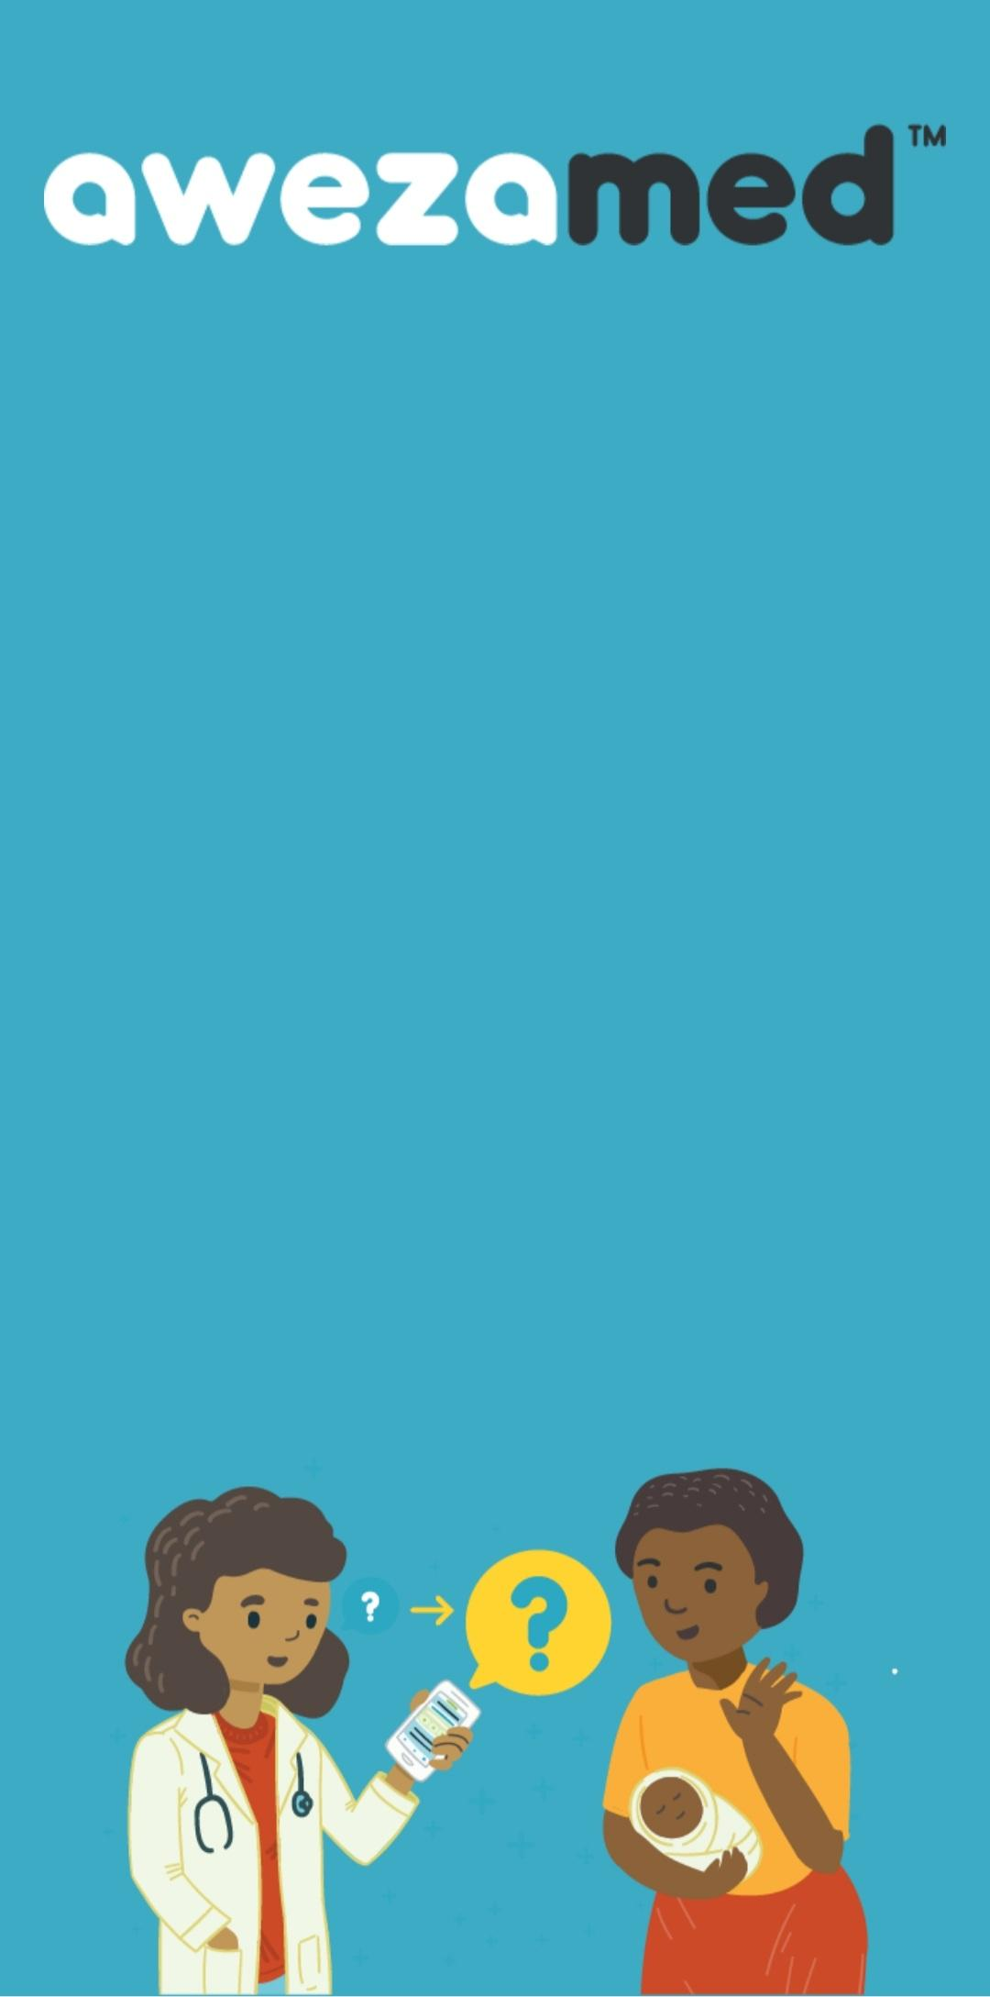
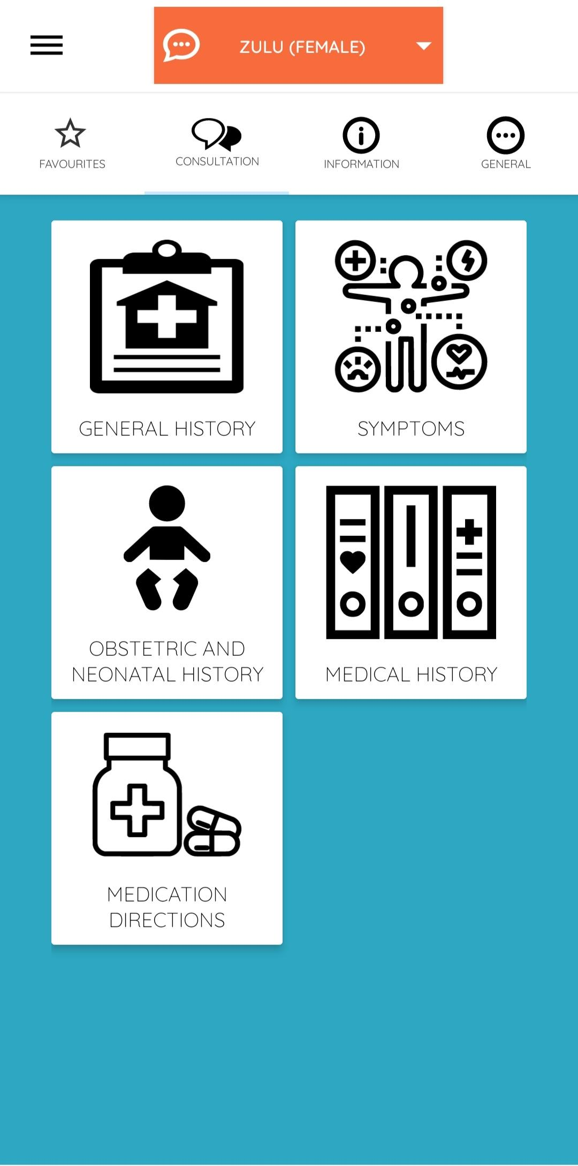
AwezaMed S2S translation app
Maternal health app that translates ~4000 English utterances to Afrikaans, Xhosa and Zulu
Supported by 5 multilingual (multimodal) GF applications grammars and mini resource grammars
Notes:
A recent project has been AwezaMed, a speech-to-speech translation application for the maternal health domain. It performs speech translation from English to Afrikaans, Xhosa and Zulu and supports about 4000 utterances.
It is built using 5 multilingual GF applications for different subdomains. The application grammars are multimodal and for the Xhosa and Zulu, they make use of mini resource grammars.

Slide 7
AwezaMed S2S translation app
Enables communication during a consultation between
English-speaking HCPs such as doctors, sisters and nurses
non-English speaking patients
Uses ASR, TTS and GF MT to achieve S2S translation
Notes:
The basic use case for the application is to enable English speaking health care providers - doctors and nurses - to “speak” to patients in their own language. All doctors and nurses in South Africa are trained in English, while their patients may not necessarily be proficient. It is uses automatic speech recognition, text-to-speech and GF-based machine translation to enable this kind of communication. In addition, the GF application grammars drive a dynamic user interface that allows users to make specific changes to an utterance and have the screen update accordingly.

Slide 8
AwezaMed S2S translation app
Maternal health domain (midwifery and obstetrics)
In South Africa, practised at
Clinics
Community Health Centres
Hospitals
HCP responsible for
respectful care → reliable, verifiable translation
App uses questions requiring “yes” or “no”
Notes:
The app targets maternal health, which is practised at various clinics, community health centres and hospitals. The mandate of these institutions is to provide so-called respectful care. Very often, when there is a communication gap between HCPs and patients, other medical staff or perhaps even cleaners and security guards, are called in to translate, and this obviously undermines the ability of HCPs to provide respectful care. In order to replace this ad hoc system with speech technology, a core requirement is reliability and verifiability.
The app is set up in such a way that the supported utterances require at most “yes” or “no” answers from patients.

Slide 9
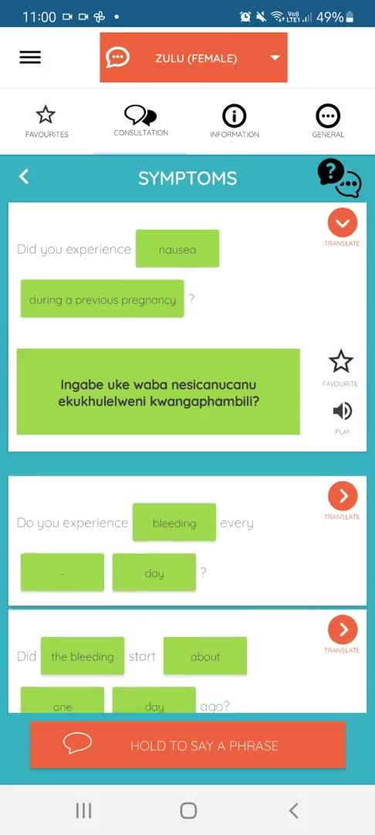
Demo
Notes:
Let’s have a look at how the app works with touch input. I had trouble recording a video using my voice, but maybe, if there’s time, I can do a live demo at the end.

Slide 10
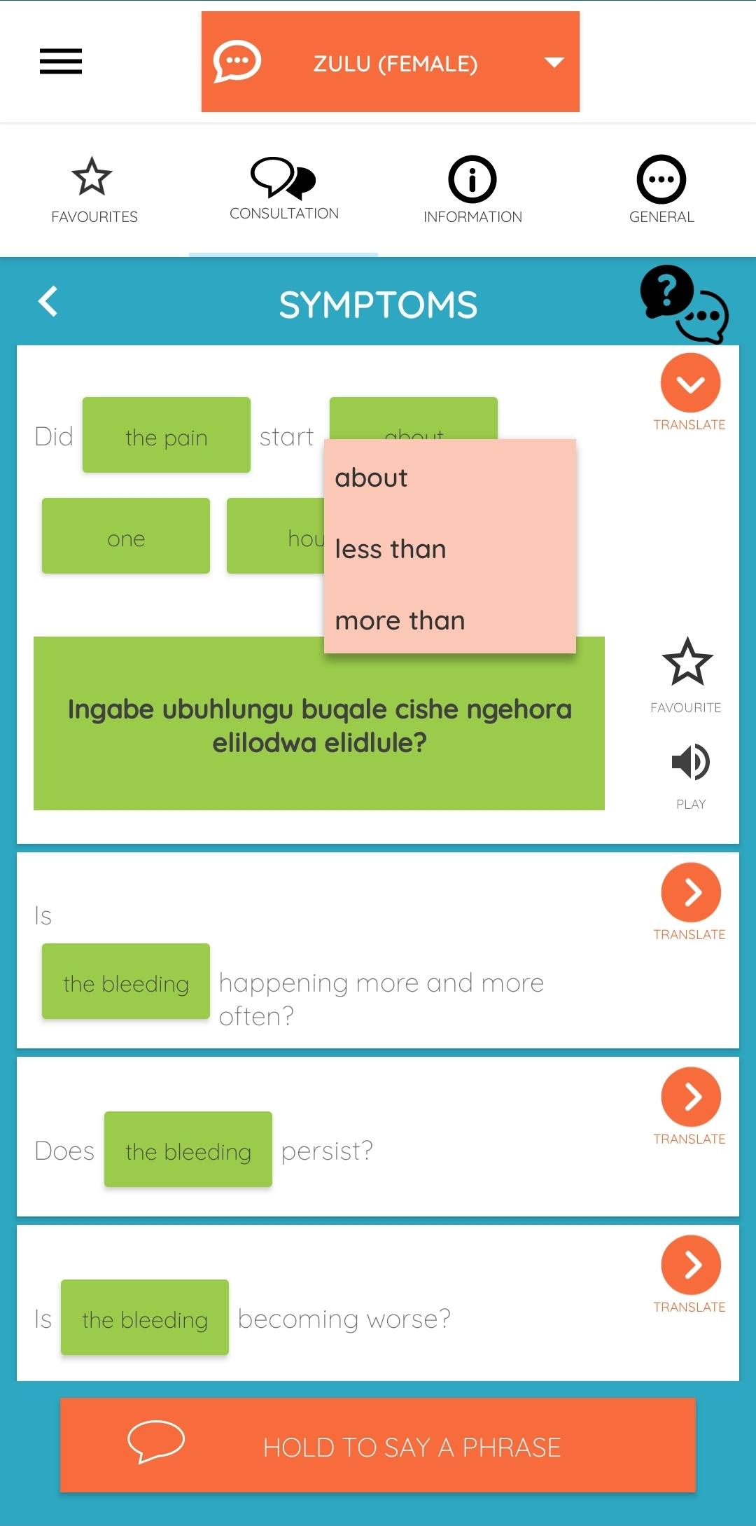


AwezaMed S2S translation app
“did the pain start about two hours ago”
Did [Symptom: the pain] start [PointTime: about] [SmallNumber: two] [TimeMeasure: hours] ago?
“Ingabe ubuhlungu buqale ngaphezu kwehora elilodwa elidlule?”
Notes:
Here again is how a typical grammar-driven screen looks. The user has two options for input - she can either make selections on a screen to construct an utterance, or she can speak an utterance supported by the app, and have the screen update in response.
The screen shows the user in the process of selecting the elements of the utterance “did the pain start two hours ago”, but speaking the same utterance would cause the screen to update with the correct content. This is important, because it serves as verification for the doctor that their utterance was recognised correctly and will therefore be translated correctly by the grammar.
The grammar is used to populare all the pieces of text on the screen by having an English version of the application grammar that produces some markup. This is used to make sure that the static pieces of text make sense given any current set of selections, but also that the alternatives in the drop down boxes make grammatical sense. For example, when the number two is selected, all the strings in the time measures list change to plural, namely minutes, hours, days etc.
A lowercase version of the English grammar interfaces with the speech recognition component. The target language text contains correct capitalisation and punctuation in order to inform the text-to-speech component.
If there is time at the end, I think it might be useful to talk a bit more about this user interface, and what it requires of the application grammar that powers it.

Slide 11
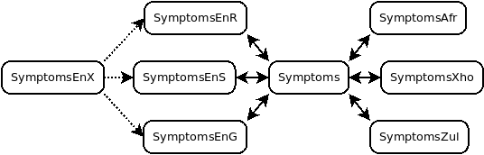
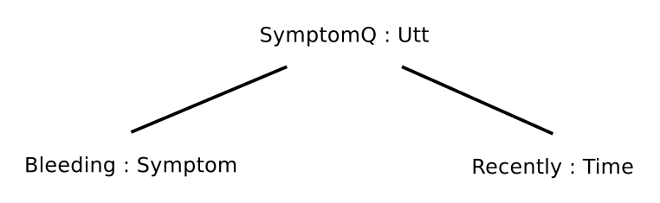
AwezaMed S2S translation app
English | Zulu
Have you experienced bleeding recently? | Ingabe uke waba nokopha kungekudala?
 | Maybe you were sometimes with bleeding recently?
Have you experienced severe headaches recently? | Ingabe uke waphatwa yikhanda elibuhlungu kungekudala?
 | Maybe sometimes you were bothered by a head that is painful recently?
Notes:
This is achieved using incomplete concrete modules for the English. For the target languages, only one version is necessary.
I want to say a quick word about the two Nguni application grammars, with Zulu as example. The semantic tree in the top right is very simple - it basically expresses the question “Have you experienced bleeding recently?”. If you changed the symptom in the tree, the English sentence would require that you change the noun phrase corresponding to the symptom. (The English was chosen to be relatively formulaic in an attempt to help users learn the utterances supported by the grammar. Obviously, one could also express the two meanings using different English constructions.)
However, such a simple change to the semantic tree necessitates a much larger change in the Zulu. Literally, the question changes from “Maybe you were sometimes with bleeding recently?” to “Maybe sometimes you were bothered by a head that is painful recently?”.

Slide 12
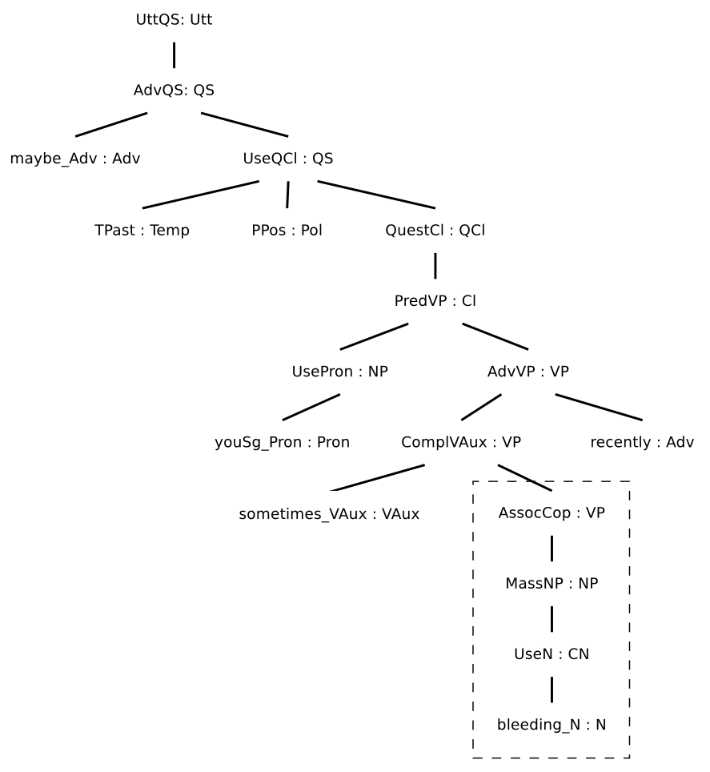
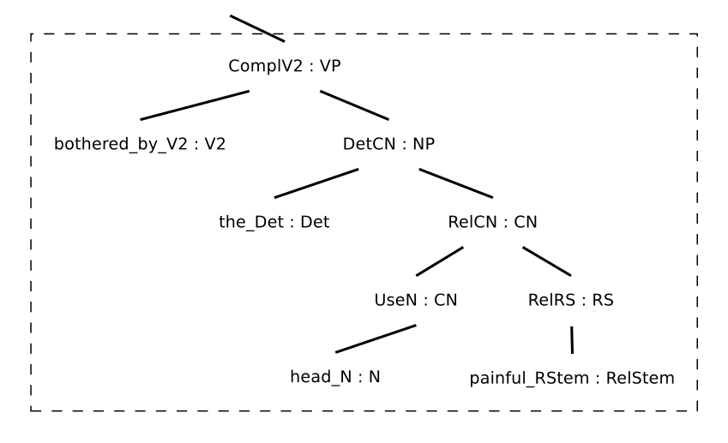
AwezaMed S2S translation app
“Ingabe uke waba nokopha kungekudala?” | “Ingabe uke waphatwa yikhanda elibuhlungu kungekudala?”
Notes:
We can see the extent of the linguistic change required by looking at the abstract syntax trees necessary to capture both sentences in the Zulu resource grammar. Besides the noun phrase that changes (as indicated in the orange text), the copulative predicate of the first sentence is replaced by a passive verb predicate in the second. This is by no means an isolated example, but a pervasive feature of the two Nguni application grammars.

Slide 13
AwezaMed S2S translation app
Piloted at 5 sites in 3 provinces of South Africa
Gauteng
Western Cape
KwaZulu-Natal
Feedback
Useful, especially in rural areas
Treat patients equally and with respect
Provide more information to patients
Finalisation of evaluation hampered by Covid-19
Adapted AwezaMed for Covid-19
Notes:
The app was piloted at 5 sites in various parts of the country. Unfortunately, the pilots themselves and our entire evaluation plan was disrupted by the pandemic last year, so the feedback has fallen far short of what we had hoped. Although superficial, what feedback we got was mostly positive and in a way it seemed to achieve our stated goal, which was to assist in enabling respectful care.

Slide 14
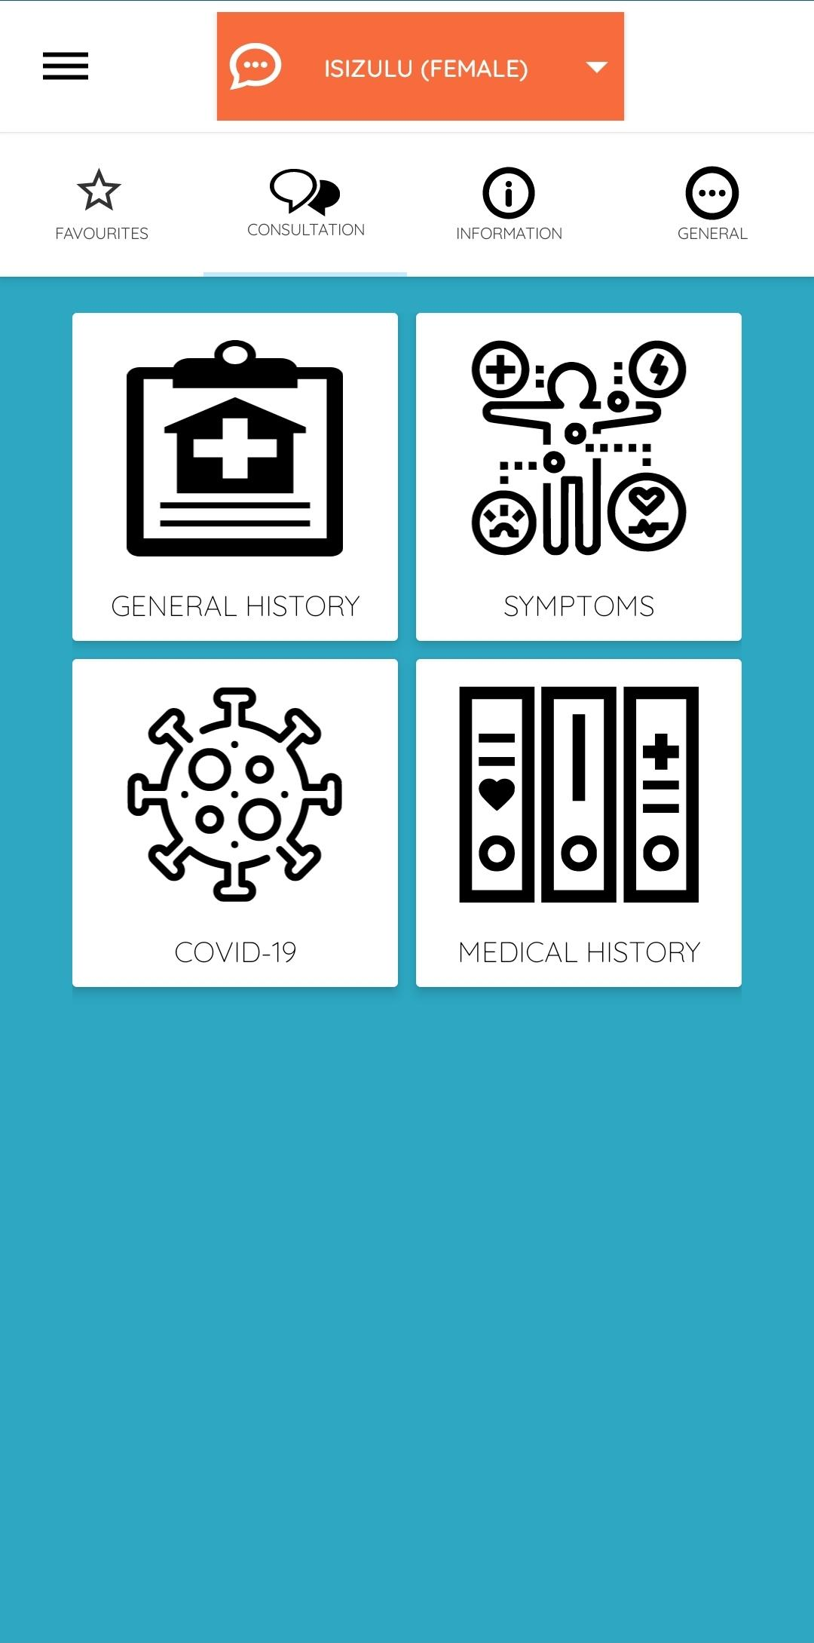
AwezaMed S2S translation app
Covid-19 app that translates ~1000 English utterances to the other 10 official languages of SA
Supported by 4 multilingual (multimodal) GF applications grammars (no resource grammars)
Notes:
We were in the last throes of development when the pandemic hit, and on the spur of the moment, in an attempt to be useful, we decided to adapt the application for Covid-19.
As during the development of the maternal health application grammars, I spent time consulting nurses and doctors about content specific to Covid-19 screening.
We adapted the abstract grammars somewhat and simplified them in order to fast track development in all the official languages.
The Covid version is currently available for download on the Play Store. I think if you searched for AwezaMed it should pop up.

Slide 15
Which corners to cut?
Workflow for maternal health app (with mRGs)
Develop abstract and English, Afrikaans concretes
Create “representative” corpus of English sentences
Obtain translations in Zulu and Xhosa
Manually analyse translations with expert linguistic help
Implement mRGs for Zulu and Xhosa to cover necessary structures
Implement Zulu and Xhosa concretes (using mRGs)
Obtain evaluation of randomly generated translations
iterative
Notes:
I want to talk a bit about what a typical workflow for developing application grammars looks like. Keep in mind that I think I am one of two people in South Africa writing application grammars - the other person being Winston Anderson - and so this is a workflow designed for someone, like me, who does not know the languages for which the grammar is written.
Okay. For the original AwezaMed application, the mini resource grammars for Zulu and Xhosa were under development kind of in parallel to the application grammar.
(Go through list)
The translations obtained basically become the seed for what the concrete syntax would include.
There were a few iterations of these steps, especially from the point of obtaining new translations onwards. Usually, the reason would be that either the translation obtained contained slightly obscure constructions that weren’t as generally applicable as I had thought. It also became increasingly clear that mother tongue input was limited in its usefulness - progress sped up quite a bit when I approached the Zulu lecturer at the University of Pretoria for help in translating and analysing the representative sentences.
It is no exaggeration to say that the professional language practitioners that were consulted initially had basically no formal knowledge of the morphology and syntax of the languages.

Slide 16
Which corners to cut?
Workflow for Covid-10 app (without mRGs)
Develop abstract and English, Afrikaans concretes
Create “representative” corpus of English sentences
Obtain translations for all other languages
Analyse Zulu translations with via (m)RG
Implement Zulu concrete directly
Bootstrap other languages from Zulu
Obtain evaluation of randomly generated translations
iterative
Notes:
For the Covid app, we didn’t have time to bootstrap the mini resource grammars, only to develop application grammars. However, the Zulu resource grammar still proved useful, as it kind of replaced the need for human help with analysing the translations.
(Go through list)

Slide 17
Which corners to cut?
Zulu workflow with RG
Develop abstract and English concrete
Create “representative” corpus of English sentences
Obtain translations for target language
Analyse Zulu translations with via RG
Implement Zulu concrete using RG
Obtain evaluation of randomly generated translations
iterative
Notes:
From this, a kind of general workflow emerged for developing application grammars using the resource grammar.
(Go through list)

Slide 18
Which corners to cut?
Zulu workflow with RG
Develop abstract and English concrete
Create “representative” corpus of English sentences
Obtain translations for target language
Analyse Zulu translations with via RG
Implement Zulu concrete using RG
Obtain evaluation of randomly generated translations
iterative
Corpus of triples: semantic tree/linearisation/syntax tree
Notes:
The bottleneck, of course, is the way the resource grammar is used.
This is a very manual process, and it requires a very specific skill set - and not one that is in oversupply in our context, namely grammar engineering and some familiarity with Zulu morphology and syntax.
Note that the analysis step basically produces a kind of parallel corpus of semantic and syntax trees, which can be extended to include linearisations as well. Maybe we could use that in some way?

Slide 19
NN instead of concrete syntax
Concrete syntax ≈ Mapping between application abstract syntax and RG abstract syntax
Can we learn such a mapping?
Can we create the data we need?
Try parsing/NLU direction first:
linearisation/syntax tree → semantic tree
direction that benefits most from increased robustness
Notes:
The development of a concrete syntax when using a resource grammar is basically defining a kind of mapping between the categories and functions in the application abstract syntax and the resource grammar abstract syntax. The question occurred to me - can such a mapping be learned?
And for this to work, can the data required be created, or augmented, from a small seed corpus?
I decided to try the parsing direction first, namely where one starts with a syntax tree - or its linearisation - and obtains a semantic tree. This is also the direction that would benefit most from allowing users more flexibility with regards to input.

Slide 20
NN instead of concrete syntax
Augmenting data via an application grammar
Corpus of triples: semantic tree/syntax tree/linearisation
Augmentation rules:
T_{A}, T_{B} → t_{a}, t_{b}
Given a semantic tree T₁ and corresponding syntax tree t₁, if a semantic tree T₂ is acquired by substituting T_{A} in T₁ for T_{B}, and a syntax tree t₂ is acquired by substituting t_{a} in t₁ for t_{b}, then t₂ is the corresponding syntax tree of T₂.
Notes:
We want to formalise the process of manually mapping the application grammar abstract syntax to the resource grammar abstract syntax. So we define the concept of an augmentation rule.
Remember that you can generate all the trees of a grammar, and specifically an application grammar.
Basically, the idea is that if you know that a specific change in the application grammar abstract syntax tree corresponds to a certain change in the resource grammar abstract syntax tree, you can use that create new resource grammar syntax trees to go with all - or many - the application grammar trees
(Read rule)

Slide 21
Question-understanding
Pivot to a GF-driven question-answering system about weather conditions
Somewhat comparable abstract complexity
Better coverage of numbers (<99), which are linguistically complex in Zulu
Allows us to focus on NLU
Notes:
At this point in the work, it was necessary to pivot to a different application grammar. Our main motivation was to counter a perception in our immediate environment that GF could only be used for translation. So we set up a proof-of-concept question-answering system that used a grammar that was not drastically smaller than any of the AwezaMed grammars. What it did cover in more detail was numbers between 1 and 99, and this is relatively significant. In the Bantu languages, numbers are not a coherent morphosyntactic category, but are expressed using quantitative pronouns, adjectives, nouns and modification of these by adjectives and nouns.
Also, the question-answering use case allowed us some freedom to focus on the natural language understanding part, usually achieved via the GF parser. In question, answering, the answer that the user receives can serve as sufficient verification of the system’s performance.

Slide 22
Question-understanding
OpenWeatherMap
WeatherQA
WeatherFactEngQ
WeatherFactEngR
WeatherFact
WeatherFactZulQ
WeatherFactZulR
Notes:
Here is the basic architecture of the GF-based QA system. A single WeatherFact abstract syntax sits in the middle, and each language is supported by a pair of concrete syntaxes: one for expressing questions about weather facts and one for expressing answers. The WeatherQA module uses this grammar as well as a web service to obtain up to date weather information.
The OpenWeatherMap One Call API provides current weather data, as well as historic data of 5 days, as well as up to the minute forecasts for the next hour, hourly forecasts for the next 48 hours and daily forecasts for the next 7 days. The WeatherFact grammar supports questions about these weather conditions for 41 major locations in South Africa.

Slide 23
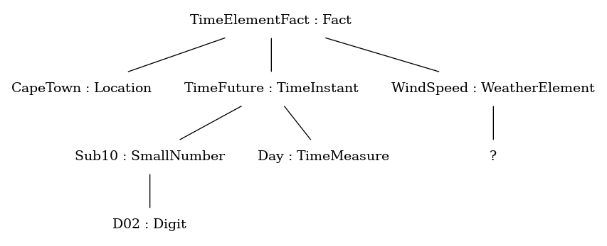
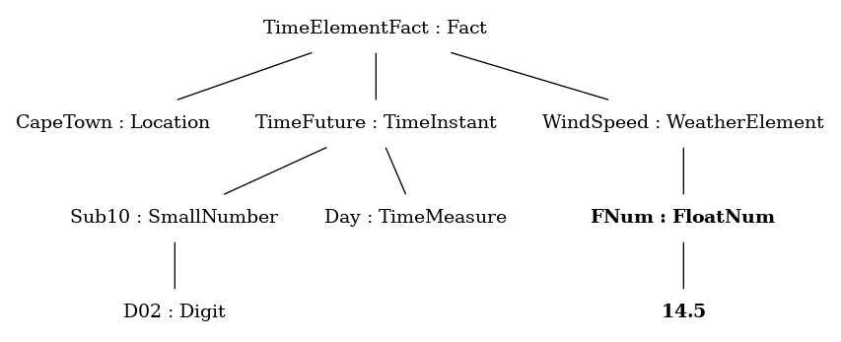
Question-understanding¹
Uzobe uvunguza kangakanani umoya ekapa ngemva kwezinsuku ezimbili?
How much will the wind blow in Cape Town in two days?
Isivinini somoya eKapa ngemva kwezinsuku ezimbili sizobe singamakhilomitha ayi-14.5.
The wind speed in Cape Town in two days will be 14.5 km/h.
https://github.com/GrammaticalFramework/gf-contrib/tree/master/weather_qa
Notes:
Question answering in this system basically comes down to completing abstract trees. By under specifying the linearisation of fact trees in the question concrete syntax, you end up with an incomplete parse tree, which contains a meta variable in the spot where the answer should go. This tells the QA engine which information to request from the weather service, and it then constructs the missing subtree to complete the tree. This tree can then be linearised as the answer to the question.
For example, ...

Slide 24
NN instead of concrete syntax
Develop abstract and English concrete
Create representative seed corpus of English sentences
Obtain two sets of Zulu translations
Obtain parse trees using Zulu resource grammar
Augment data to obtain many more semantic-syntax-linearisation triples
(Evaluate augmentation)
Linearise augmented syntax trees to obtain semantic-syntax-Zulu triples
Train NN that maps Zulu/syntax tree to semantic tree
try different flavours
Notes:
Okay, so now we want to simulate the concrete syntax for questions suing a neural network. Here is the workflow that was followed.
The representative corpus is constructed by choosing a template sentence and varying one category in the sentence. From this, you can figure out what effect this category has on the sentence.
The data is then augmented by defining rules. These could be automatically derived from the seed corpus, but it is not a difficult manual process, because you kind of know where to look, having set up the seed corpus in a specific way.
Then, the augmented data is evaluated. At this point, it would become clear if your choice of seed corpus was sufficient, because errors might pop up. In the case of the weather grammar, the only errors that were found was the incorrect use of the immediate future and past tenses where the remote tenses ought to have been used. For example, because the grammar allows all numbers up to 99, the grammar allows sentences like “what will the weather in Johannesburg be like in 78 days?”. For this, you need the remote future, but the OpenWeatherMap service only gives data for 7 days. So we didn’t fix this in the augmented data, but we could have done so if necessary.
Once you have obtained a lot of semantic/syntax tree pairs, you can linearise them to obtain triples. Then, you are ready to train some networks.

Slide 25
NN instead of concrete syntax
Parse translations
Extend the WIP Zulu RG to obtain 148/152 parses, with at least one for each English sentence
Augment data
148 utterance seed corpus → 341 254 utterance augmented corpus
Balance corpus
Duplicate* some utterances based on size of semantic tree
Notes:
I want to make some remarks about the preparation of the data. From the 152 translations we received, we managed to extend the Zulu resource grammar to parse 148, including at least one translation per English sentence.
Using our augmentation process, we generated over 300K triples. We checked against all possible trees in the application grammar, and only a very small set of trees were missing, namely those with numbers starting with zero.
Because some utterances contained numbers up to 99, these kinds of utterances were disproportionately represented in the augmented data, so we performed a machine learning heresy by duplicating data to balance the corpus. (The other option was to throw data out, but since we were not primarily interested in generalising beyond our data, this didn’t make much sense.)

Slide 26
NN instead of concrete syntax
Input flavours
Zulu linearisation, tokenised on word boundaries
Zulu linearisation, tokenised on syllable boundaries
Zulu linearisation, tokenised at character level
Syntax tree string
Lemma sequence (lexical functions)
Output flavours
Semantic tree string eg “TimeElementFact CapeTown (TimeFuture (Sub10 D02) Day) (WindSpeed ?)”
Keyword sequence* eg “CapeTown TimeFuture D02 Day WindSpeed”
Notes:
The next step was to think about how the inputs and outputs of the neural networks would look.
We wanted to try and exploit the new Transformer architecture, so we set up the problem as a sequence to sequence one.
For input, …
For output, we opted for something similar to the lemma sequence for the input, namely a keyword sequence. This meant that we did not expect to obtain fully formed trees from the neural network. However, writing a concrete syntax that could parse such keyword sequences is trivial. This also seems the safer route, because it seemed that a sequence to sequence neural network might not be very good at inserting parentheses that balance, but it might be good at producing keywords that could be traced back to the input tokens in some way.

Slide 27
NN instead of concrete syntax
WeatherFactEngQ
WeatherFactEngR
WeatherFact
WeatherFactKeyQ
WeatherFactZulR
transformer_zul
transformer_?
Notes:
This diagram shows the new architecture we would therefore be aiming at. A keyword question concrete syntax replaces the Zulu question concrete syntax, and it is used to parse the output of a sequence-to-sequence neural network, which, in turn, receives some representation of a Zulu question.

Slide 28
NN instead of concrete syntax
Evaluation
Test set selected from augmented data set
Can the NN approximate a concrete syntax?
New translations
Is the NN more robust?
Preparing an independent test set
Seed corpus is minimal and representative ito concepts, but not balanced
Augment new translations in the same way (71 parses → 138 896)
Randomly select 100 sentences
Notes:
The next question to address was that of evaluation. Obviously, we could split out augmented data into training, validation and test sets. Testing in this way would basically answer the question of whether the sentences that we would have modelled using a concrete syntax could be successfully “understood” using the neural network in conjunction with a keyword concrete syntax.
However, we wanted to go one step further. One possible advantage of using neural networks is improved robustness - could our neural networks do better on other kinds of input that we might want to be able to handle well?
For this, we decided to obtain two new, independent sets of translations. These sentences did not make up a great evaluation set, because they were simply new translations of the original seed corpus. They were not, therefore, a balanced set of sentences. So, we decided to try and augment them in the same way. This time, the grammar was not extended to parse them, and we only managed to parse 71 out of 152. (Keep in mind that the resource grammar is still being developed.)
Anyway, we obtained a lot of new sentences and then randomly selected 100 of them as an additional evaluation set.

Slide 29
NN instead of concrete syntax
Model | F score (test) | P score (test) | F score (new) | P score (new)
token2key | 1.0 | 100% | 0.65185 | 33%
syllable2key | 1.0 | 100% | 0.83098 | 54%
char2key | 0.99537 | 97.84% | 0.81897 | 52%
syntax2key | 1.0 | 100% | 0.81894 | 52%
lemma2key | 0.99966 | 99.67% | 0.83629 | 53%
lemma2key* | N/A | N/A | 0.18702 | 0%
Notes:
Here are the results. The F score is the well known measure that balances precision and recall, while we defined the P score, which is the percentage of perfect predictions achieved by the model. This is an indication of how many times the model produced exactly the right keyword sequence, and hence where the user was perfectly understood.
The blue indicates the scores achieved on the original augmented data test set. The green indicates the scores achieved on the independently translated and augmented data.
Discuss.

Slide 30
Conclusion
GF is a good fit for speech and language applications for resource scarce languages
In South Africa, resource scarcity starts with human resources
A RG could provide the leverage to generate enough custom data to train models that perform similarly to application grammar concrete syntaxes
Less flexible in some ways
More flexible in other ways

